Slide 1
OSG202 LAB 01
ASSIGNMENT REPORT
Installing the Fedora OS on a virtual machine
Student
ID
Class
Nguyễn Đăng Lộc
SE160199 SE1602

Slide 2
Table of contents
Install the Fedora 34
03
Install and use the Midnight Commander
12
Install and use the Fedora Eclipse for C/C++
14
02

Slide 3
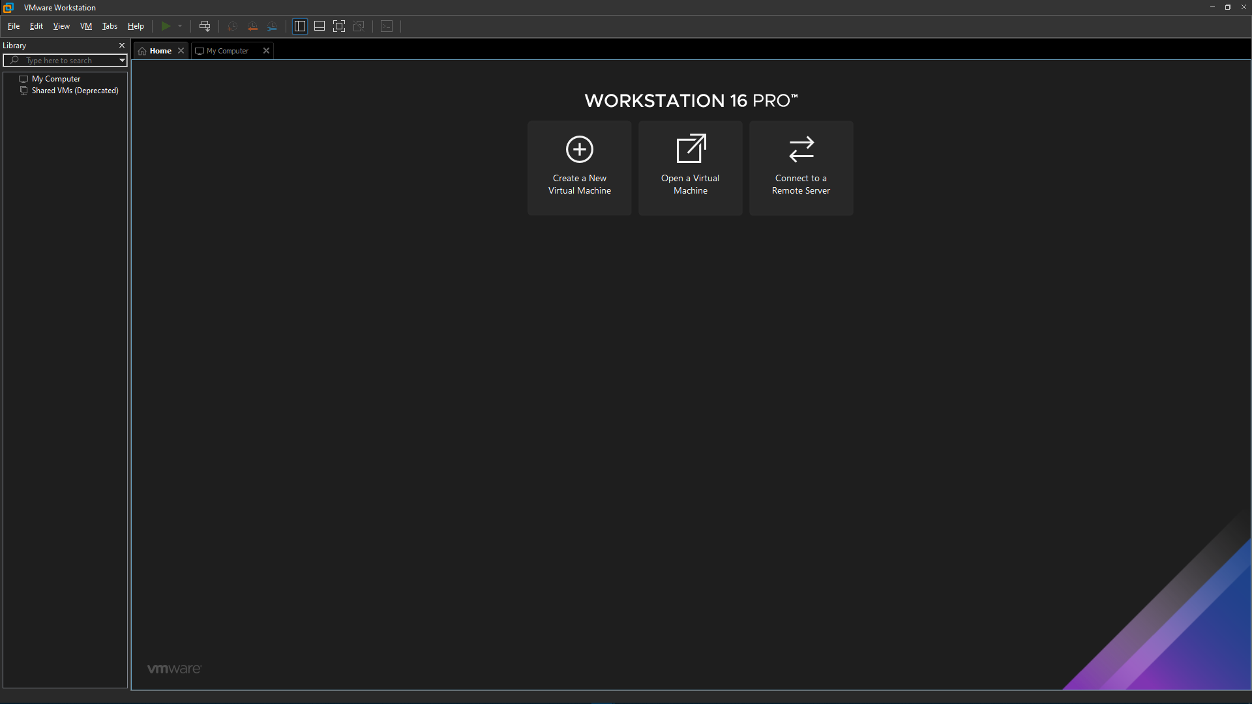
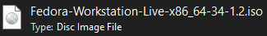
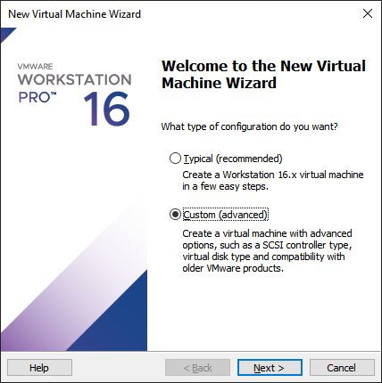
1. Install Fedora 34
1.1. Preparation
1.1.1. Get the VMWare Workstation 16.0 installation (download from its website)
1.1.2. Prepare the ISO file of Fedora 34
1.1.3. A disk space that store all needed file of the Fedora on a disk (remains greater than 10GB empty space)
My setup space
D:\STUDY\2021\SEM 2 - Summer\OSG\Labs\LAB_01
1.2. Install the Fedora 34
1.2.1. Starting setup the Fedora by click on Create a New Virtual Machine
Choose Custom (Advanced) → Click Next
03

Slide 4
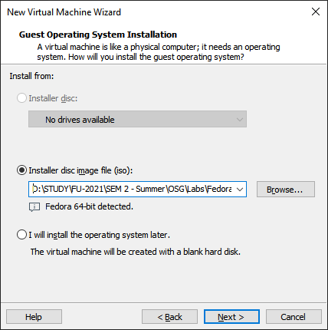
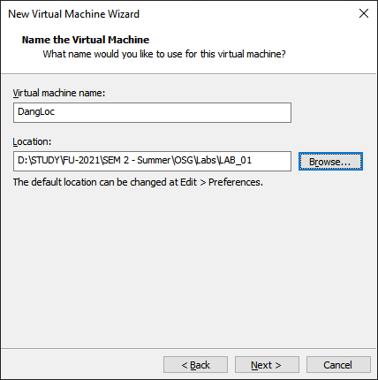
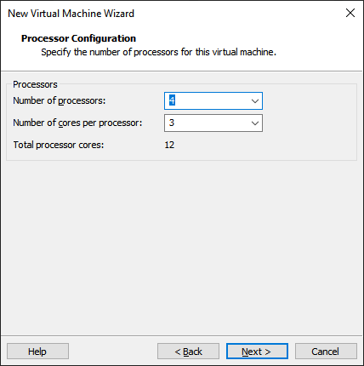
1.2.2. Browse the ISO file of the Fedora 34
1.2.3. Choose a VM name and specify the OS’s storing folder
1.2.4. I set 4 processors and 3 cores per processor because I want the OS to perform multitask faster and more smooth
04

Slide 5
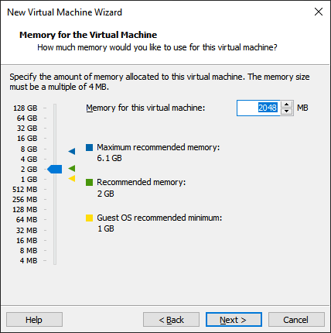
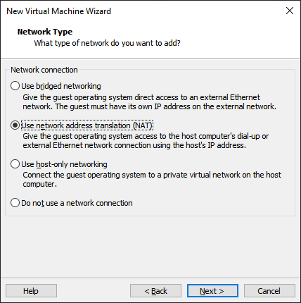
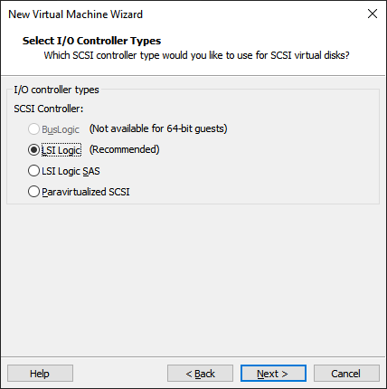
1.2.5. Specify the RAM capacity of the VM, I set is as default (2048MB)
1.2.6. I choose NAT option for easy Internet connect without domain configuring
1.2.7. I choose LSI Logic as a type of IO controller since it was recommended
05

Slide 6
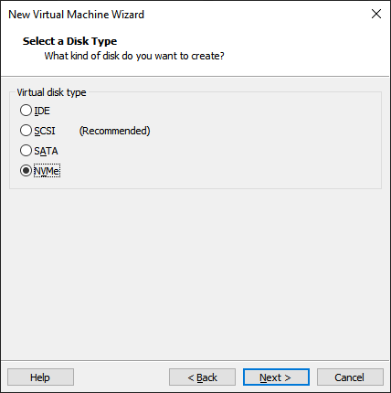
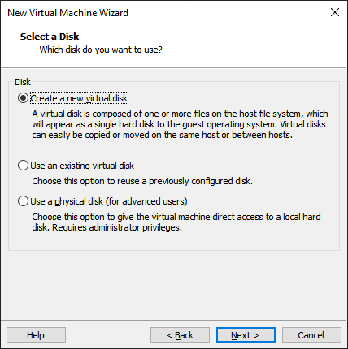
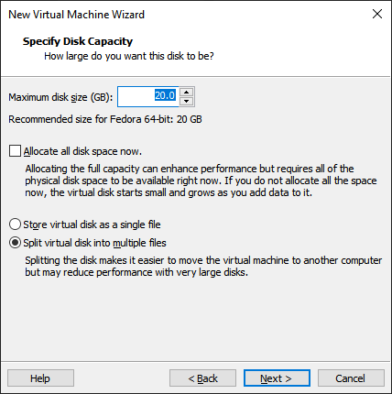
1.2.8. As my computer use NVMe SSD, I decided to choose NVMe disk type for conformity
1.2.9. Tick to the Create a new virtual disk option (it’s a file only on the physical disk)
1.2.10. Specify the maximum disk size
06

Slide 7
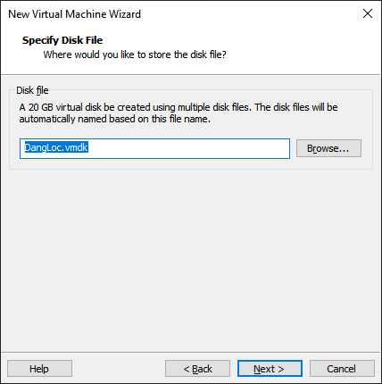
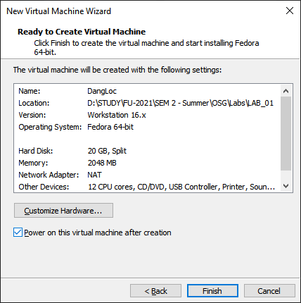
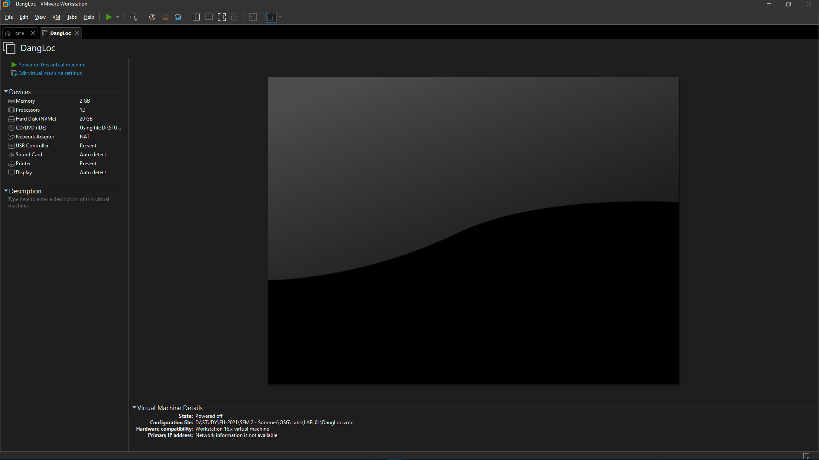
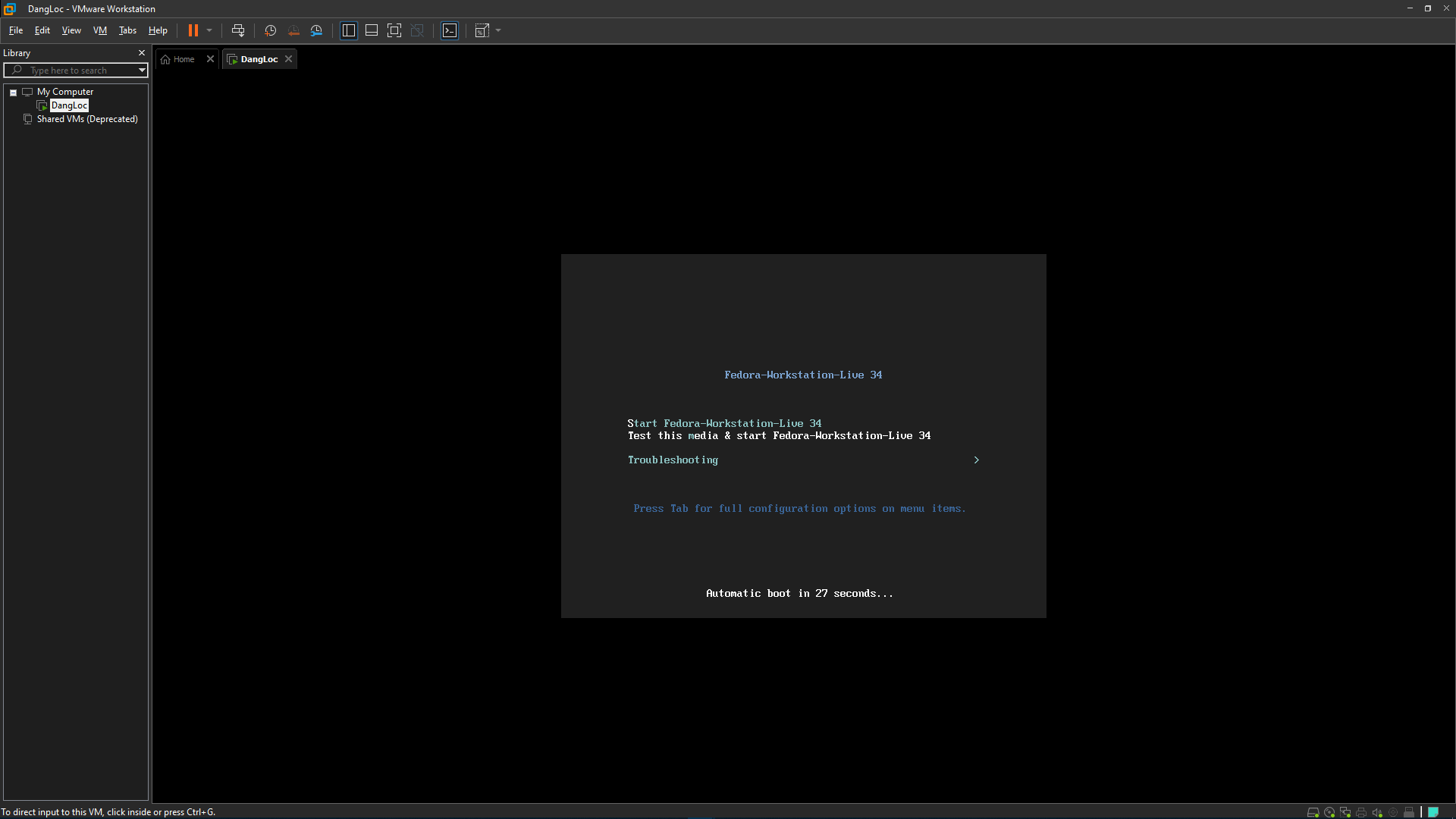
1.2.8. The next 2 steps, I left them as default → Tick on Finish
I choose Power on this virtual machine after creation for
Hence, the VM will be created and it will start instantly after that.
The VM data after íntallation
07

Slide 8
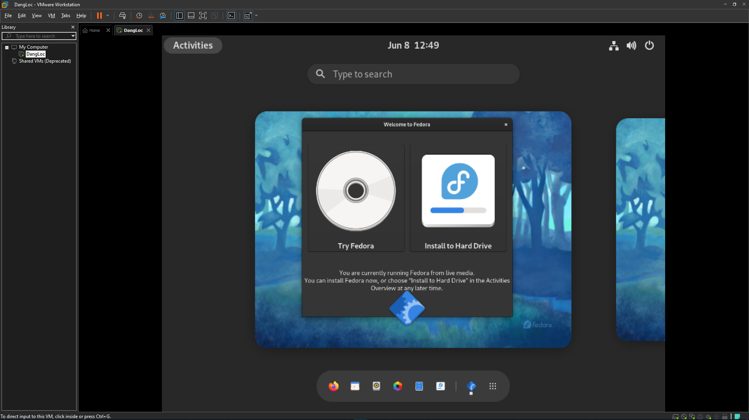
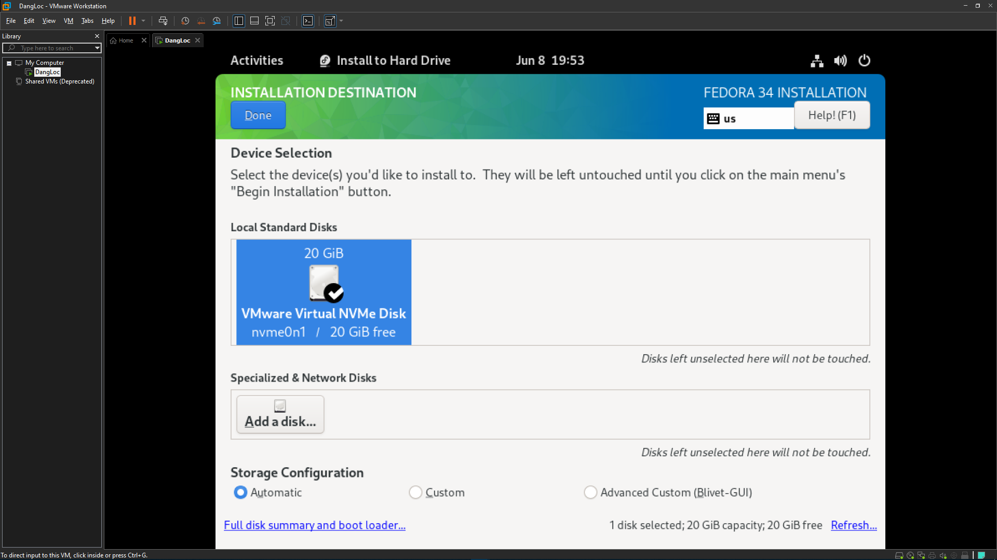
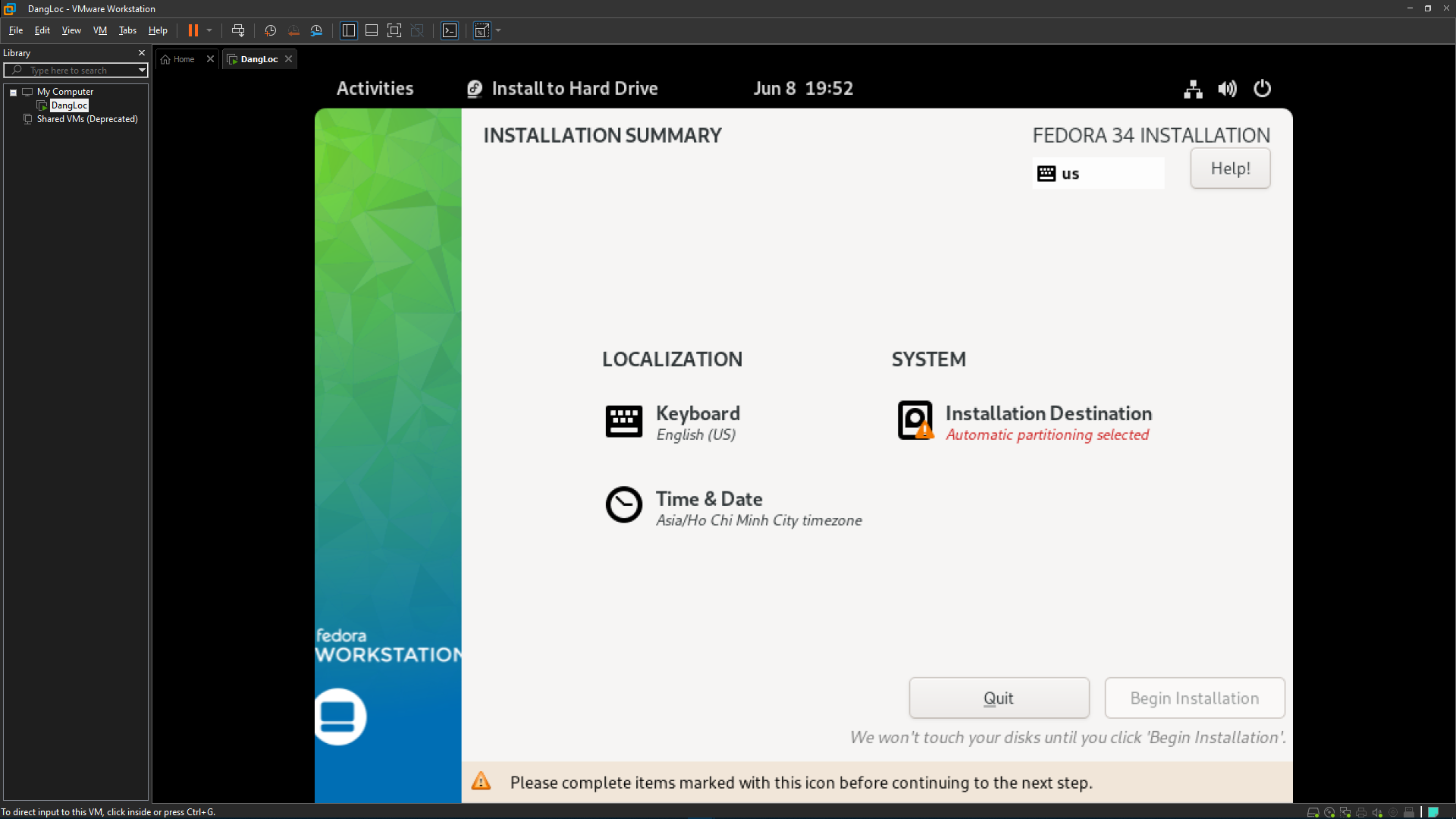
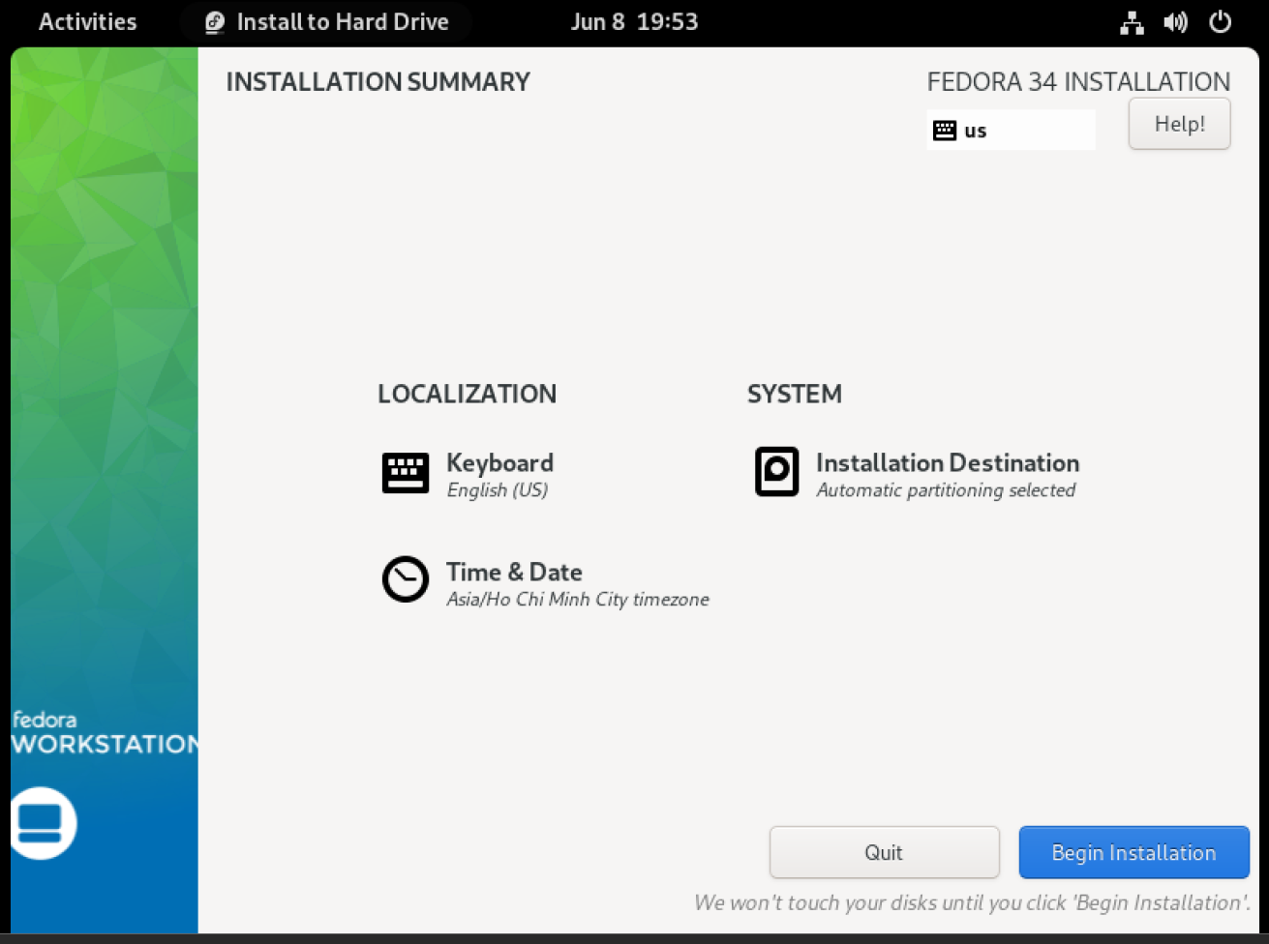
1.2.9. After the VM powered on, the final step of installation is installing it to Hard Drive
The progress required me to choose a destination when installFedora to Hard Drive, and I choose a Local standards disk I have already set up in the earlier phases.
08

Slide 9
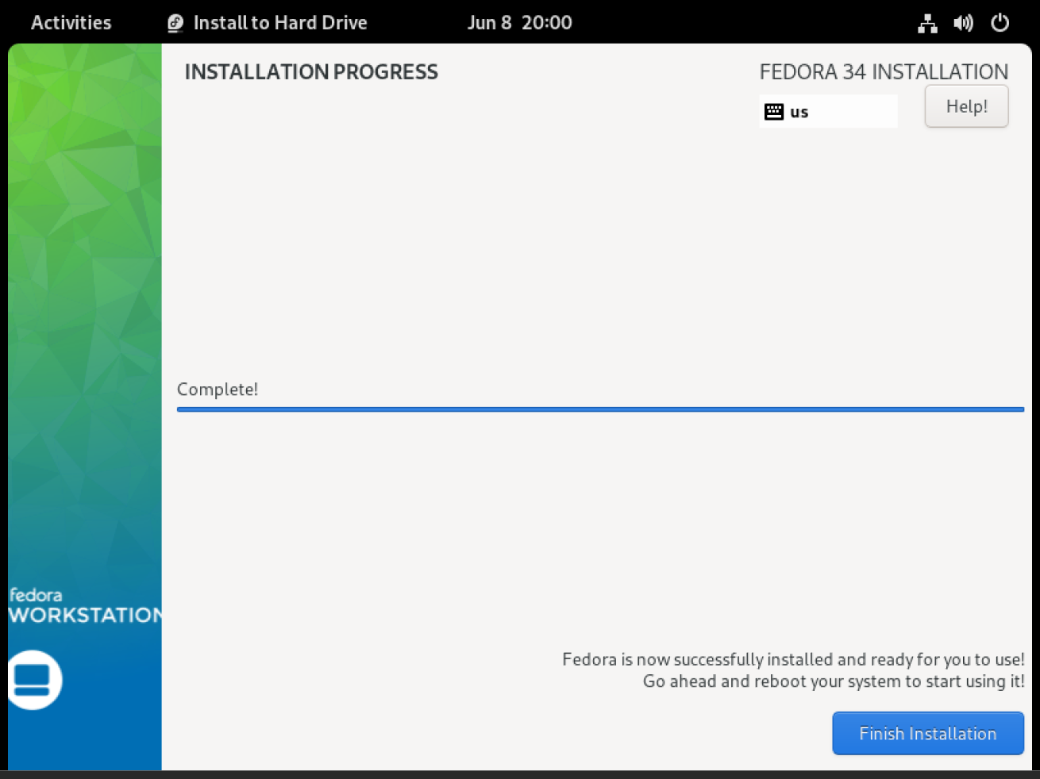
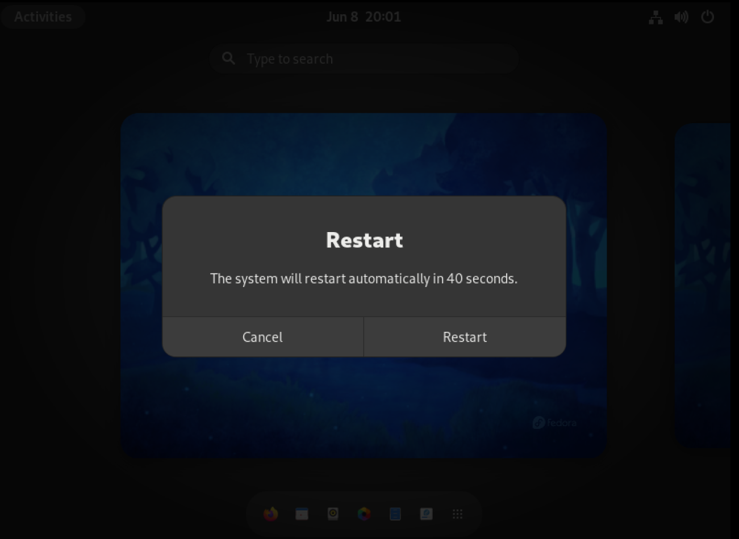
1.2.9. The installation is finish, Fedora require restart to jump in setup
The installation progress is finished and it suggested that I reboot the machine to complete some last step s like: set user name and password, choose a network, another personal services, etc.
The next slides show the final setup interface and the GUI of the Fedora 34 I have installed completely.
09

Slide 10
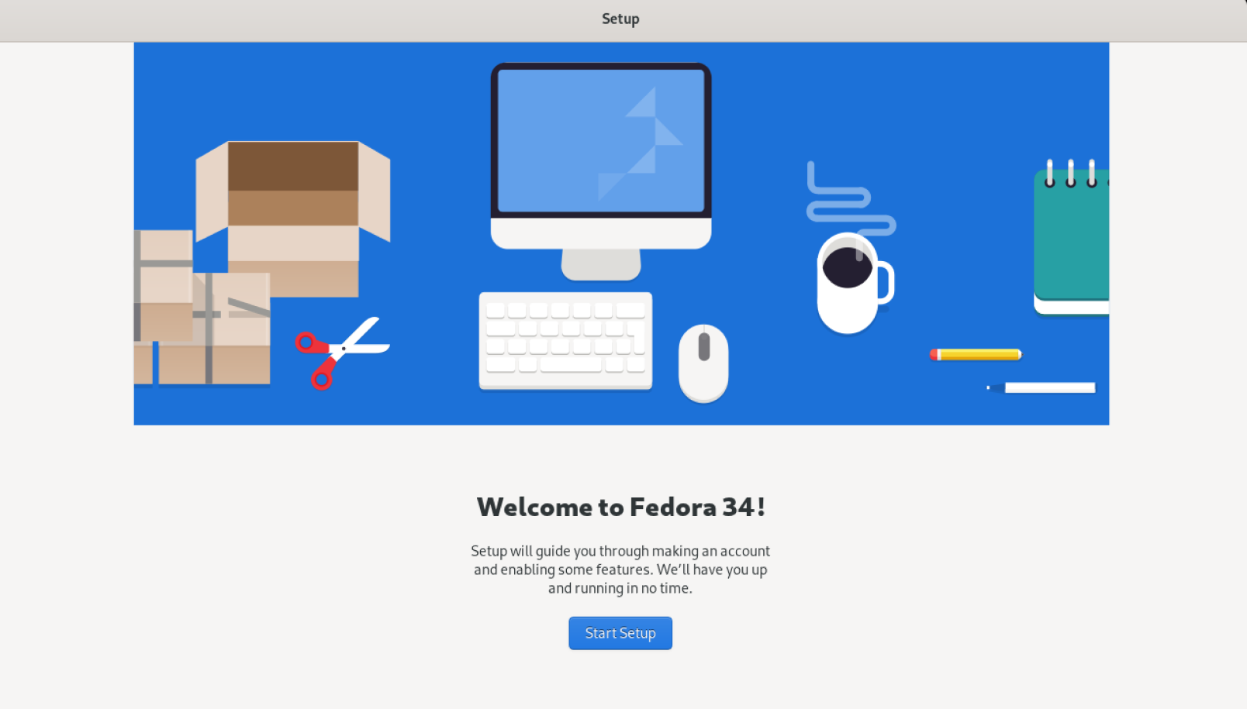
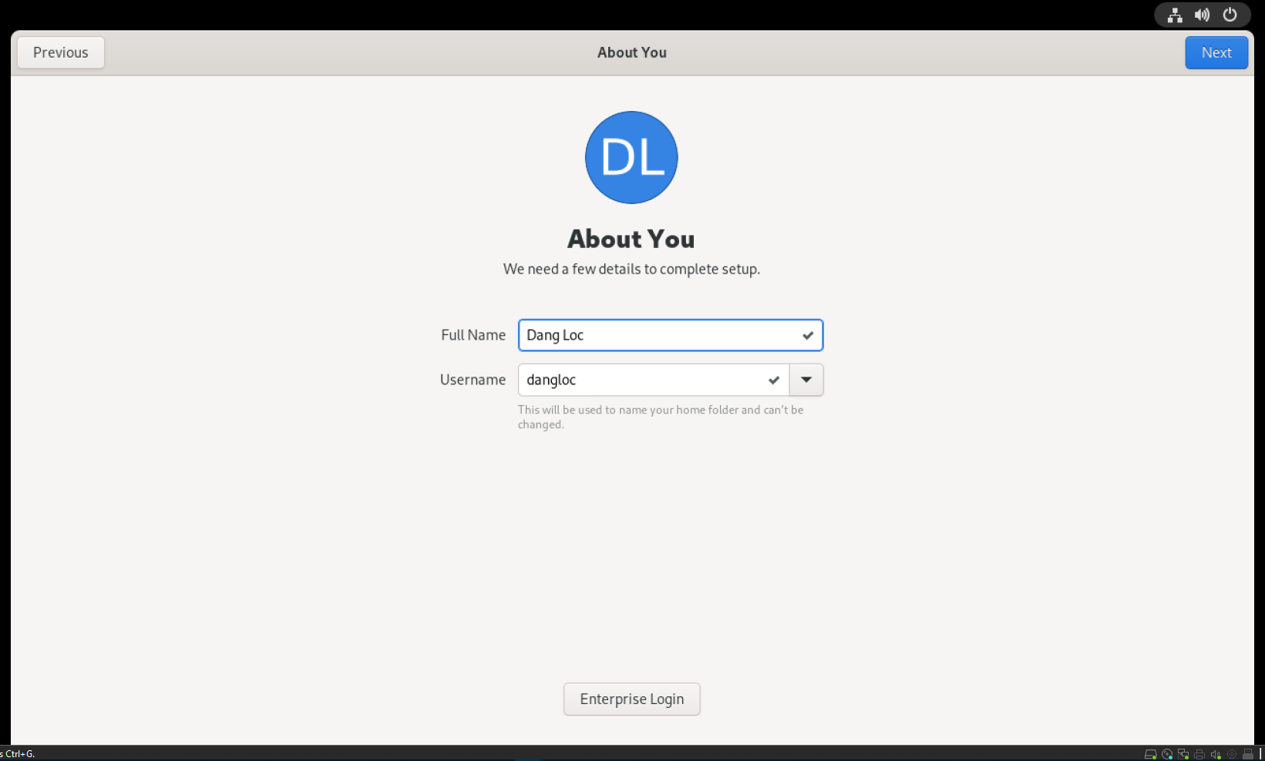
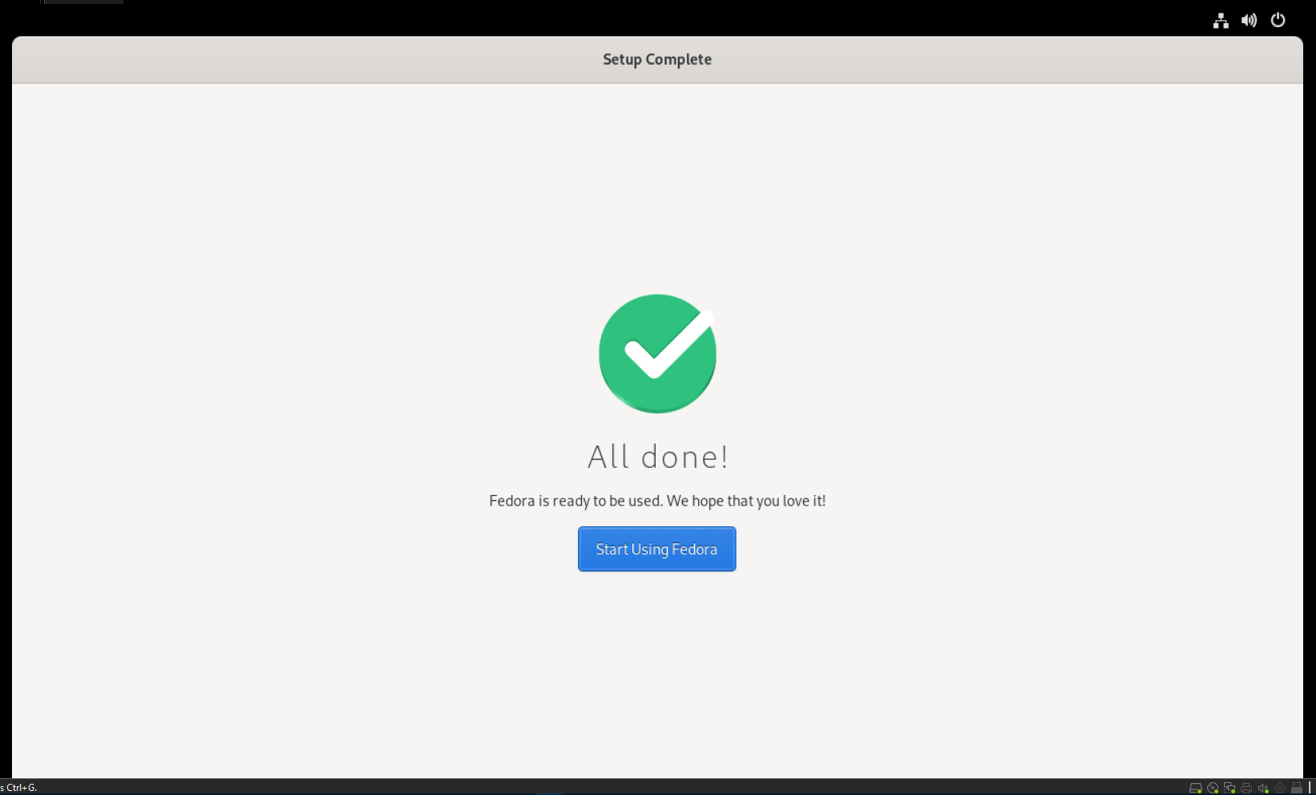
10

Slide 11
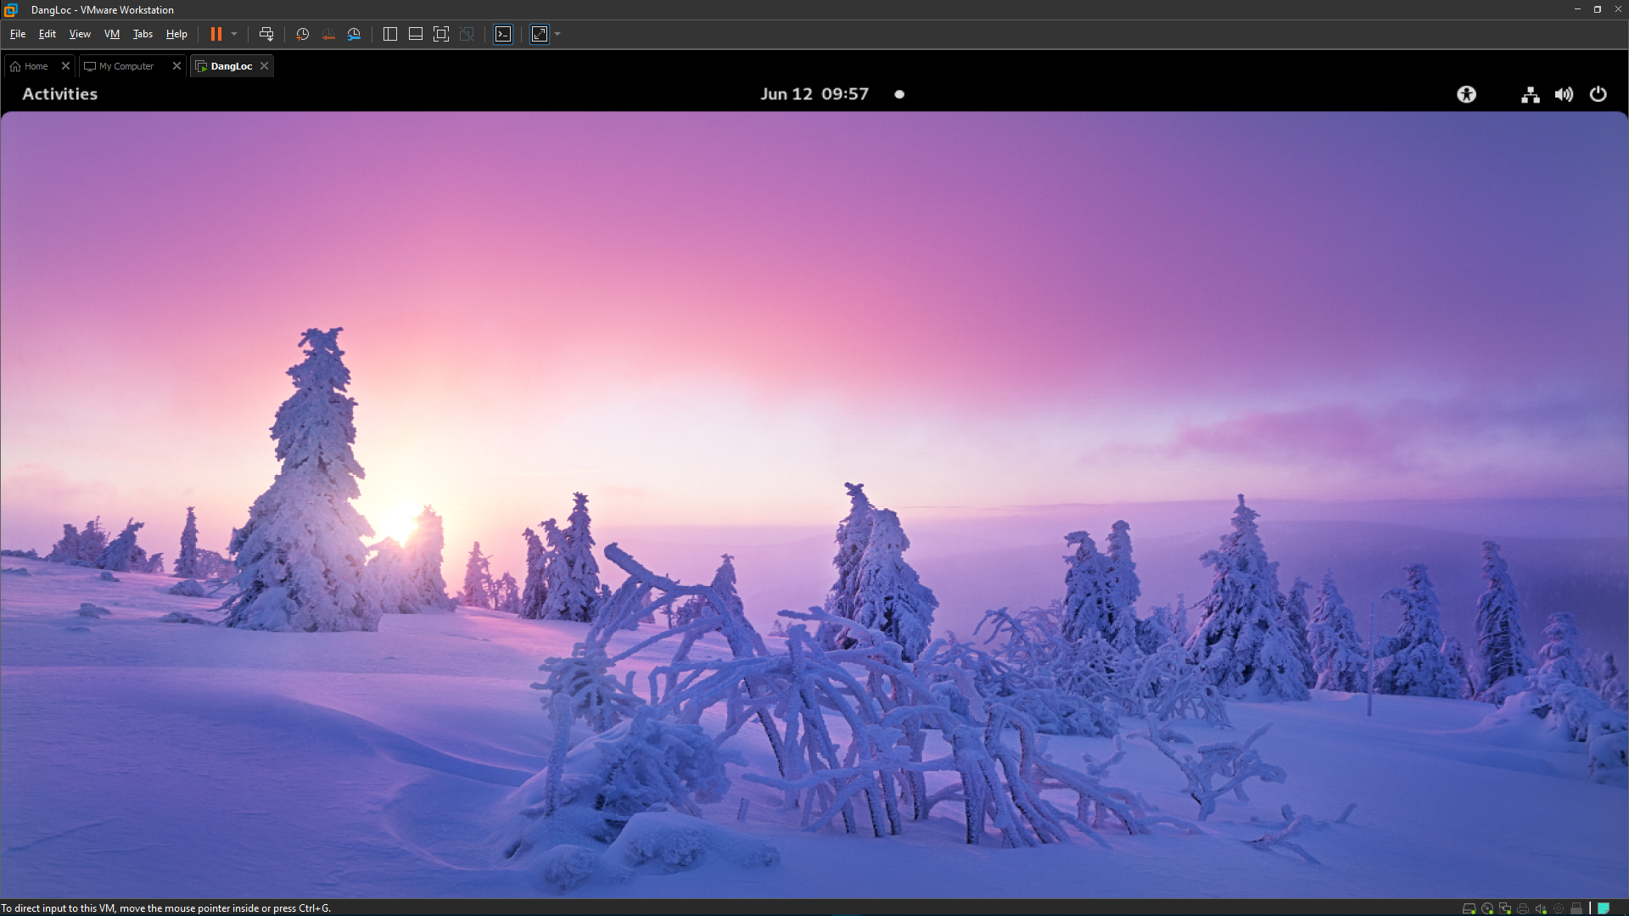
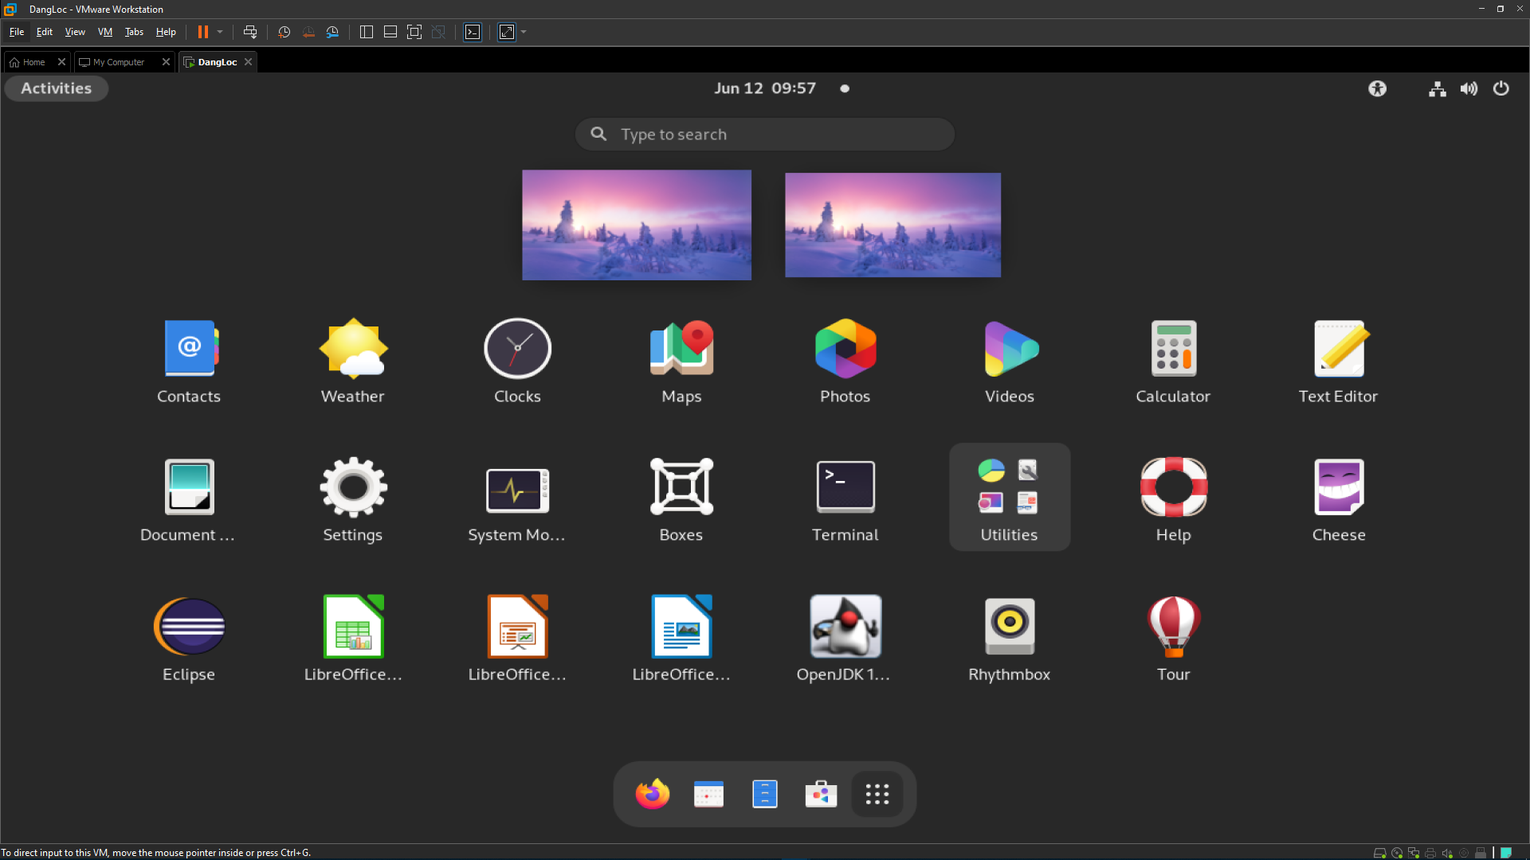
1.2.10. Fedora 34 GUI
11

Slide 12
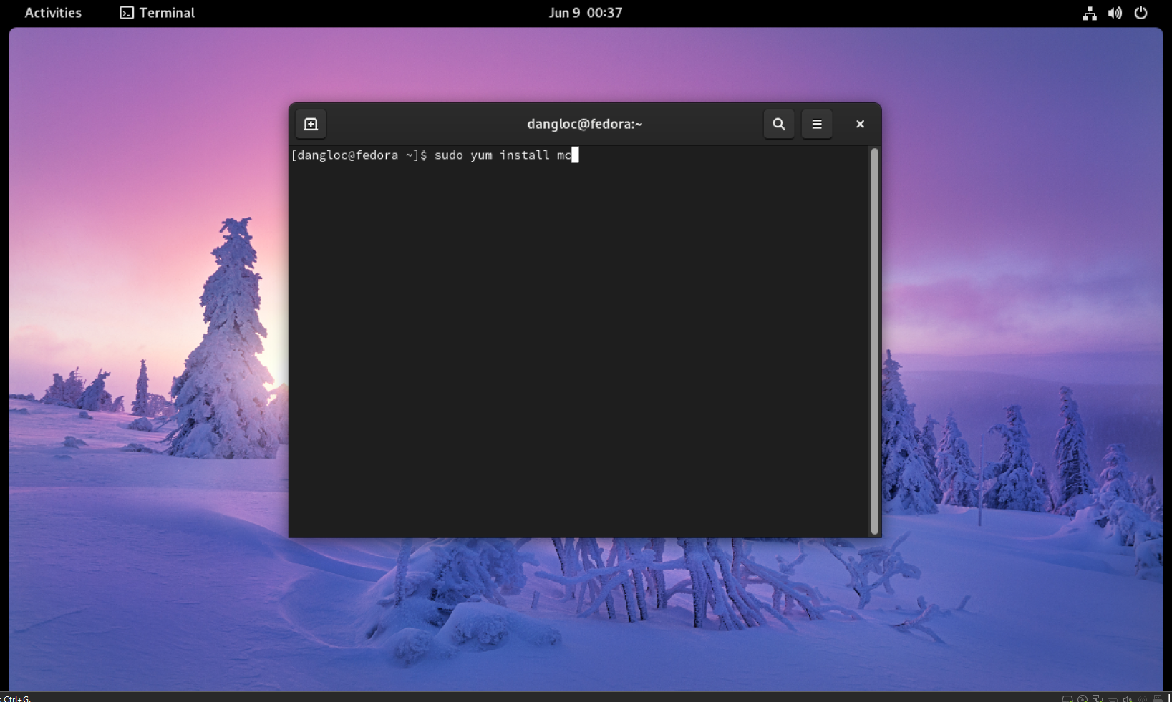
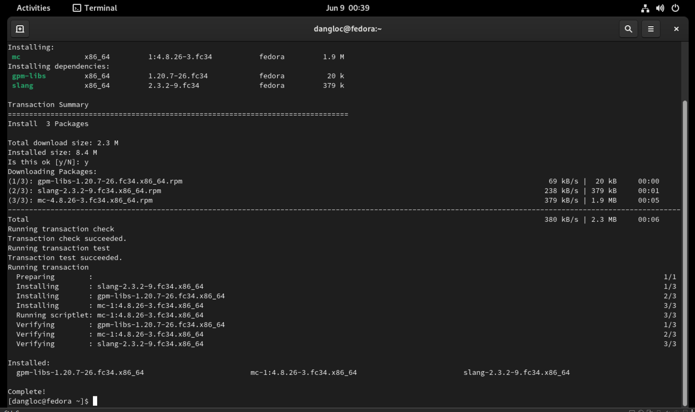
2. Install and use the MC
2.1. Use YUM to install package
I use YUM to install Midnight Commander package
YUM is the primary tool for getting, installing, deleting, querying, and managing Red Hat Enterprise Linux RPM software packages from official Red Hat software repositories.
The installation has been completed!
The package is located at /usr/bin (default)
12

Slide 13
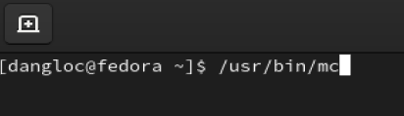
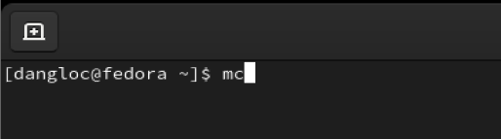
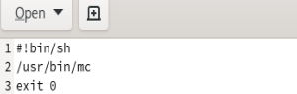
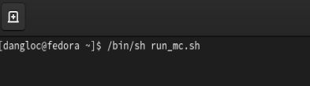
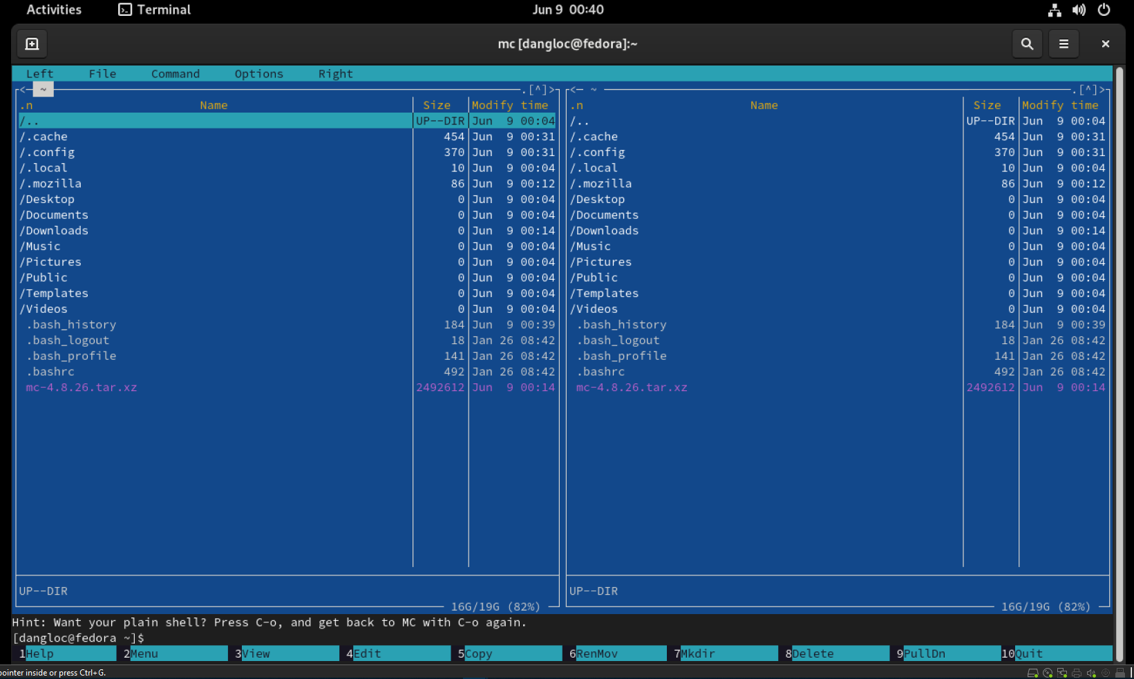
The MC run only in the console mode, so I run it in Terminal window using command primts as shown below
OR
Create a script file to run the MC easily
→
13

Slide 14
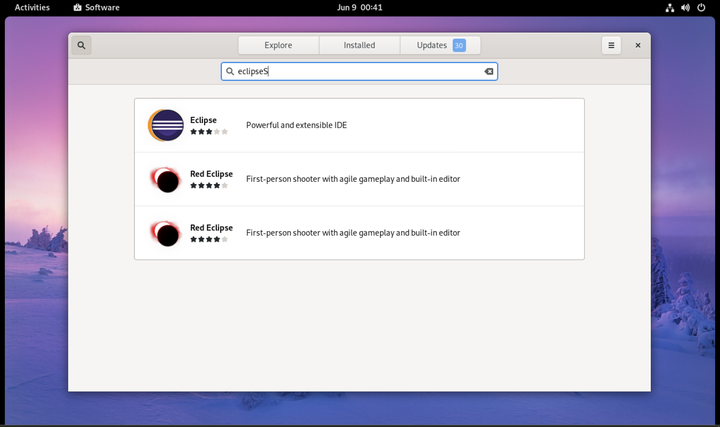
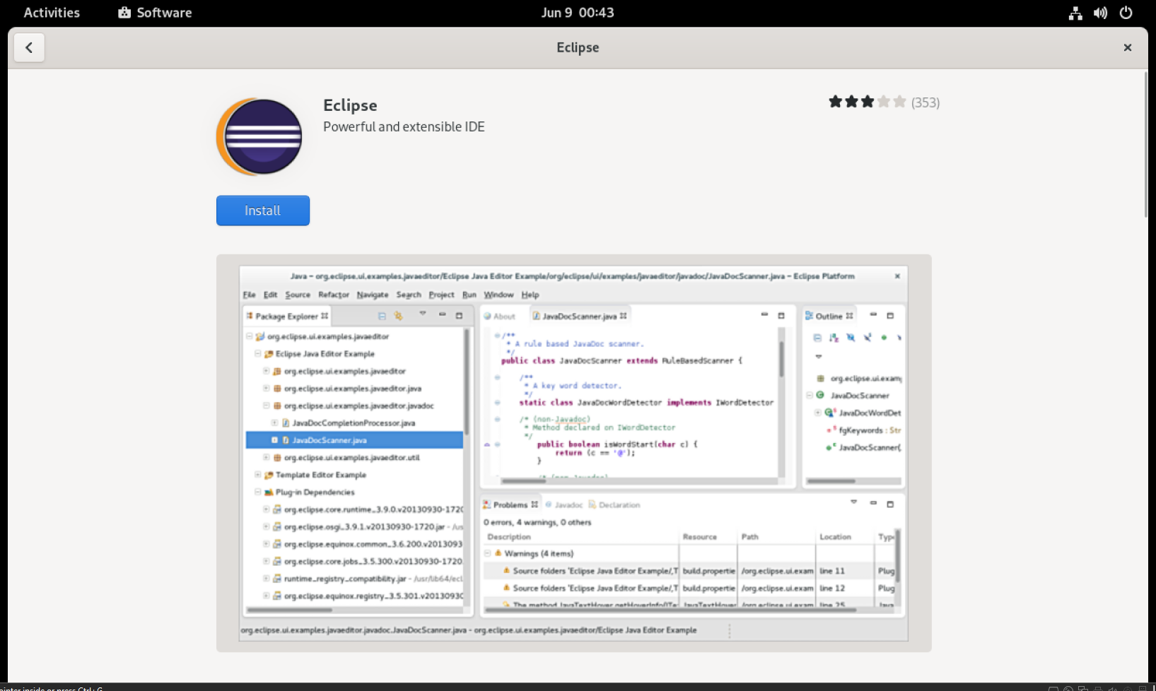
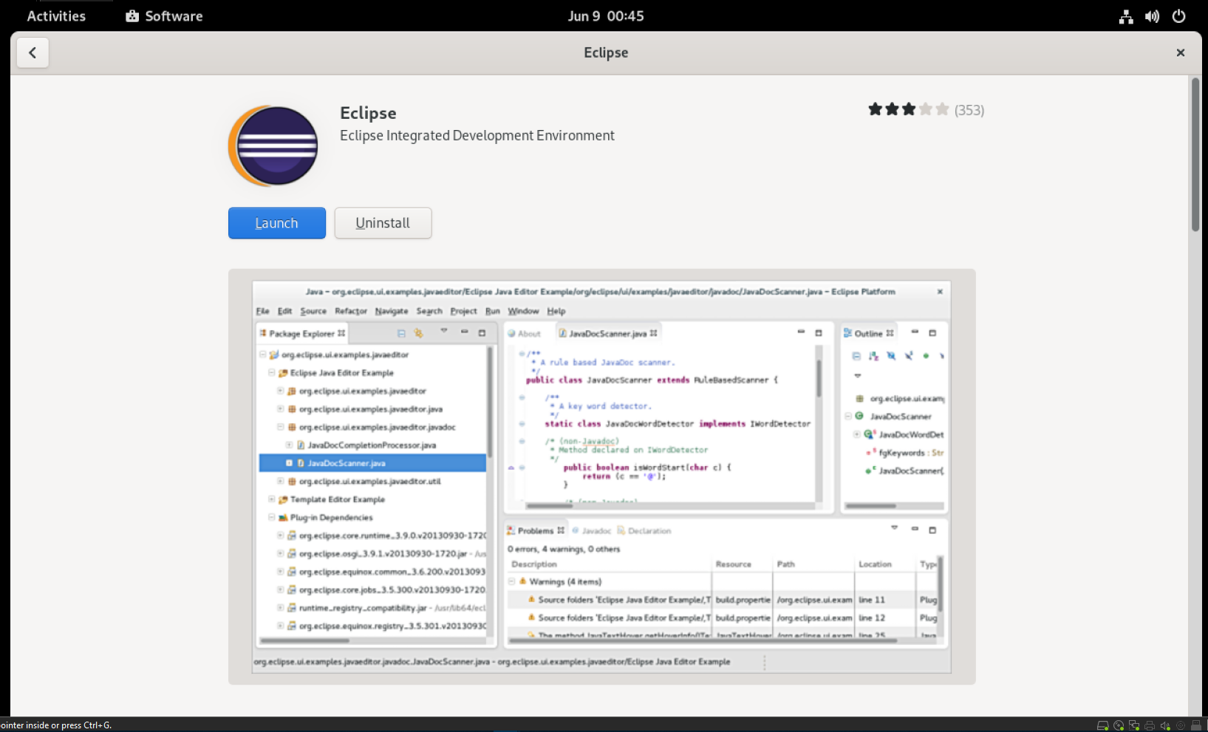
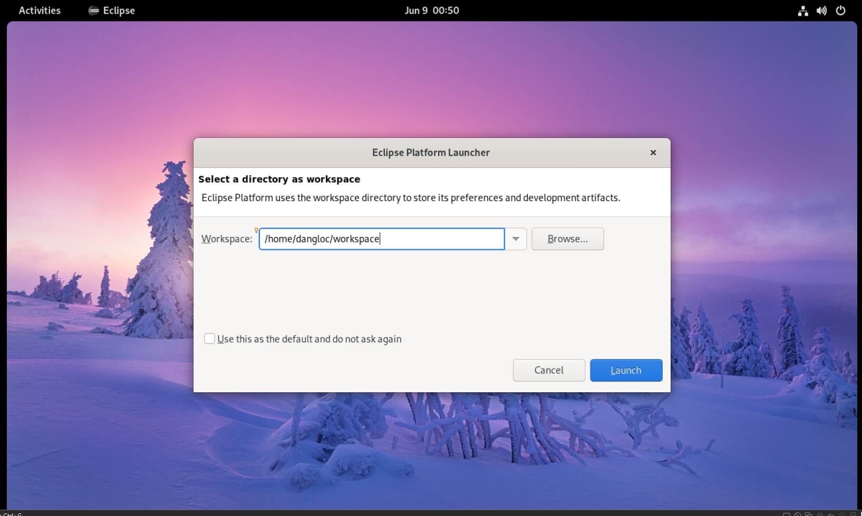
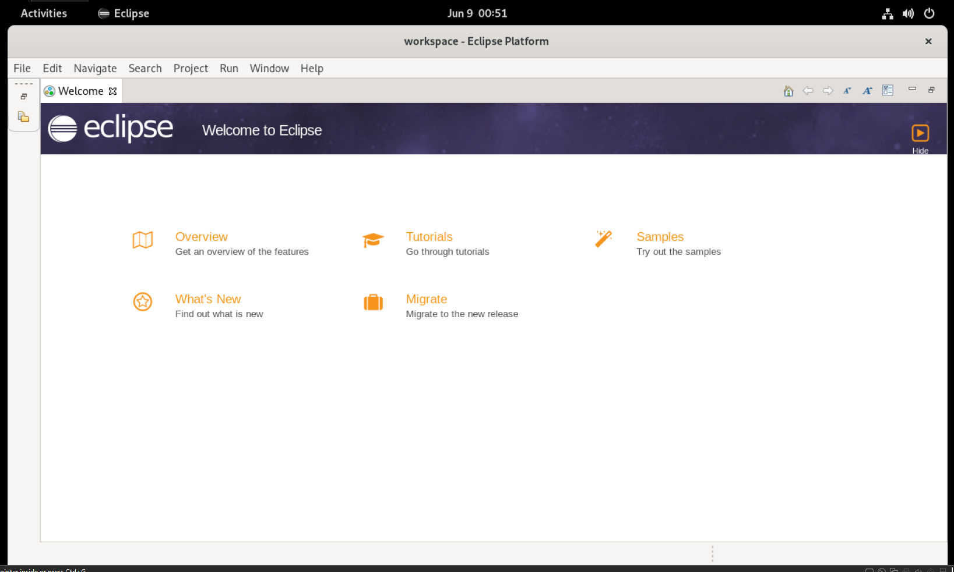
3. Install the Eclipse for C/C++
3.1. Find and install Eclipse IDE from Software Browser of Fedora 34
3.1. Use YUM to install package
I search for Eclipse IDE and luckily the Software Browser of Fedora 34 already had got the install file.
Installation complete and I choose my default workspace.
Below is the GUI of welcome page of Eclipse
14

Slide 15
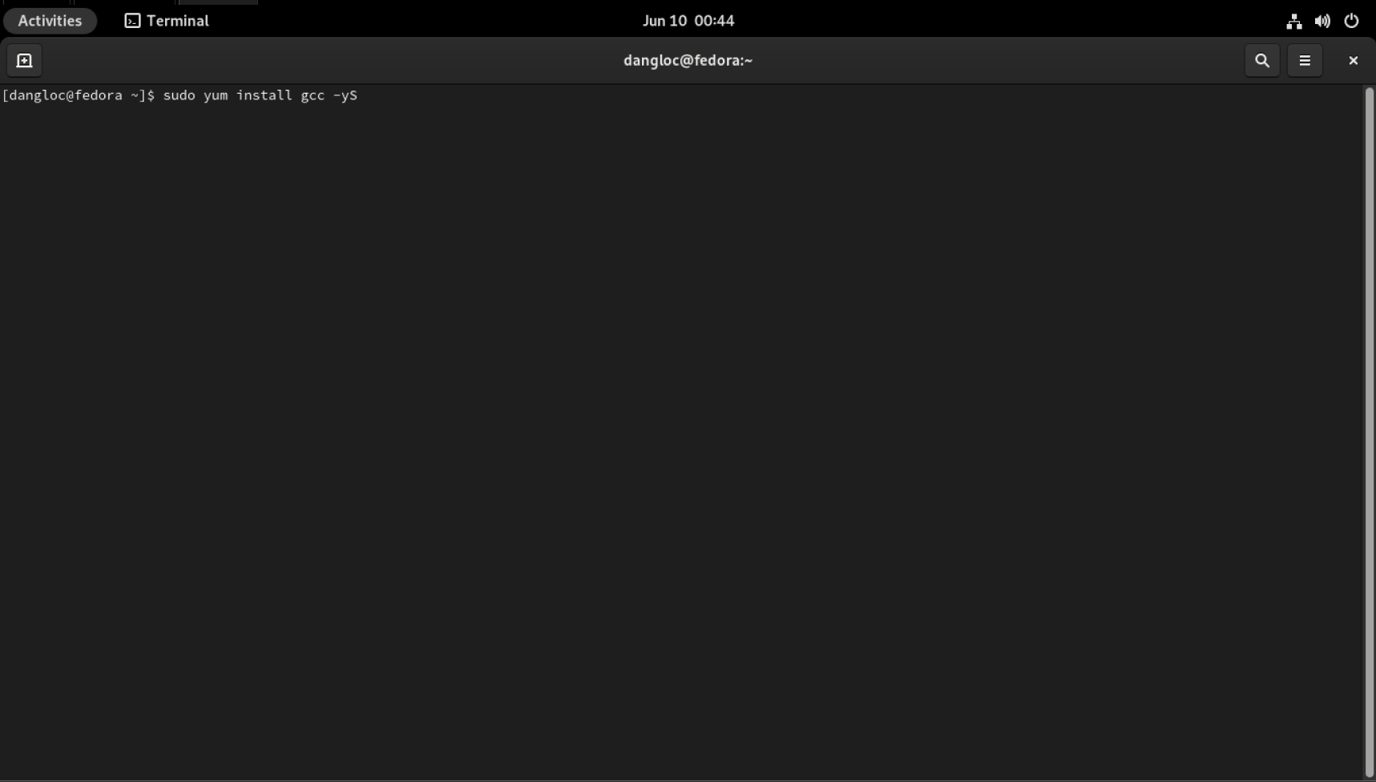
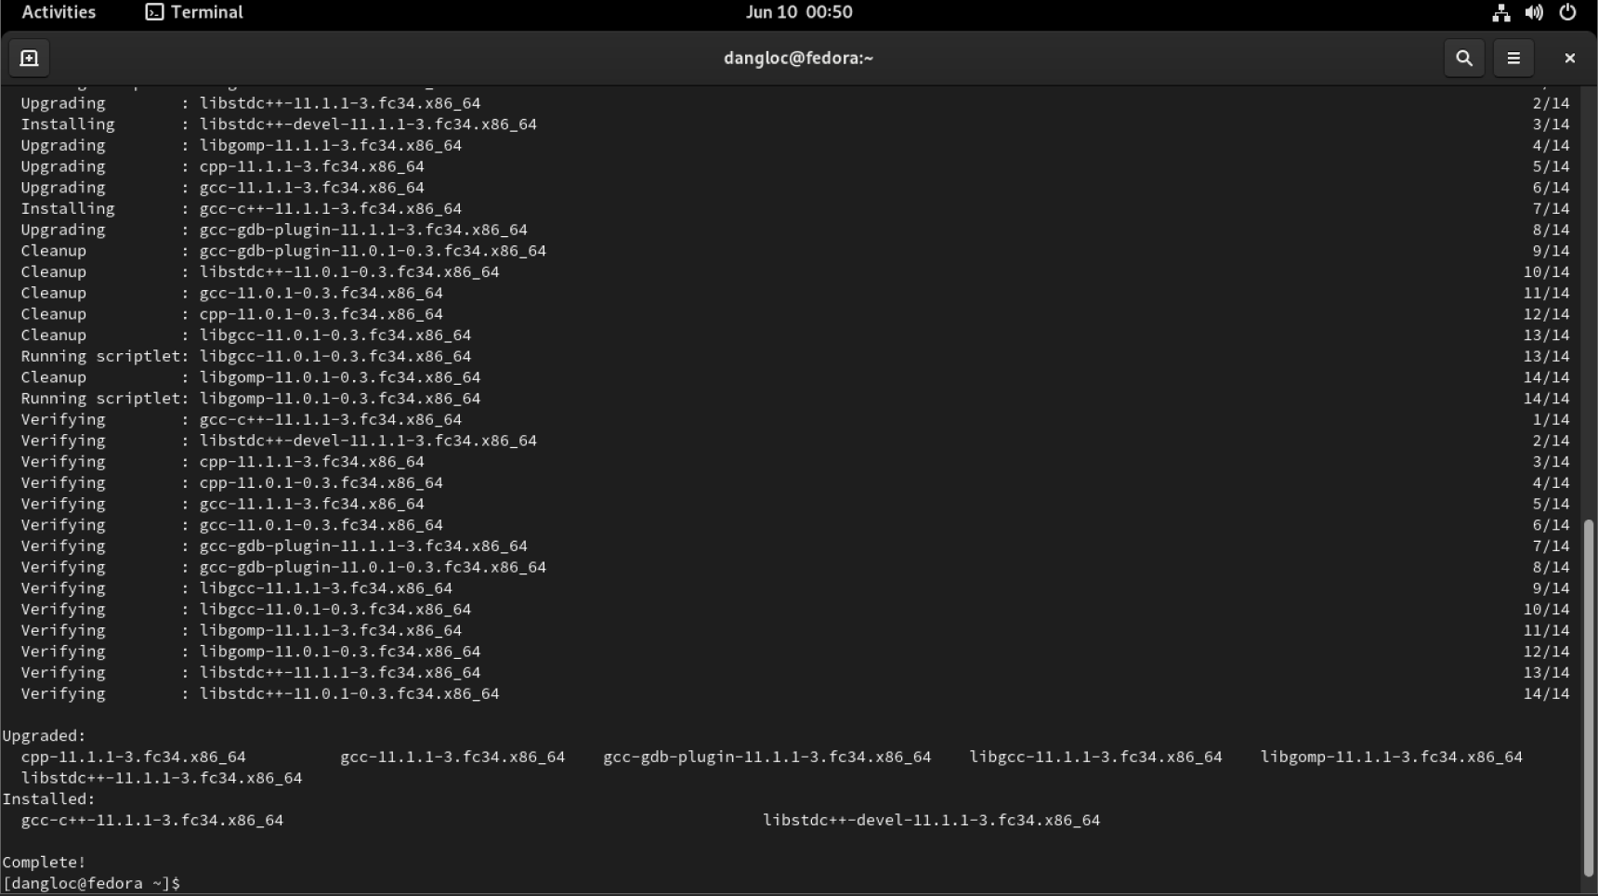
The step before just install the IDE without any compiler. To prepare for coding in C/C++ with Eclipse, I have to install MinGW GCC compiler. (As shown below)
3.1. Use YUM to install package
04
15

Slide 16
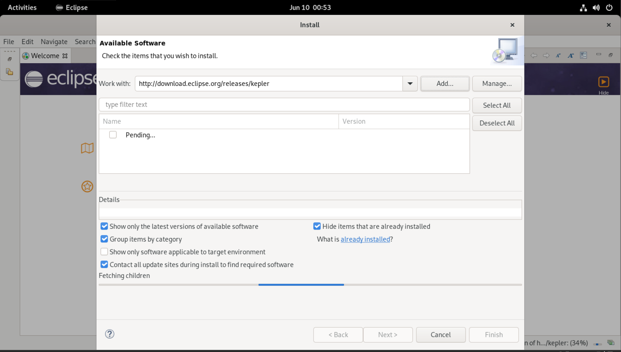
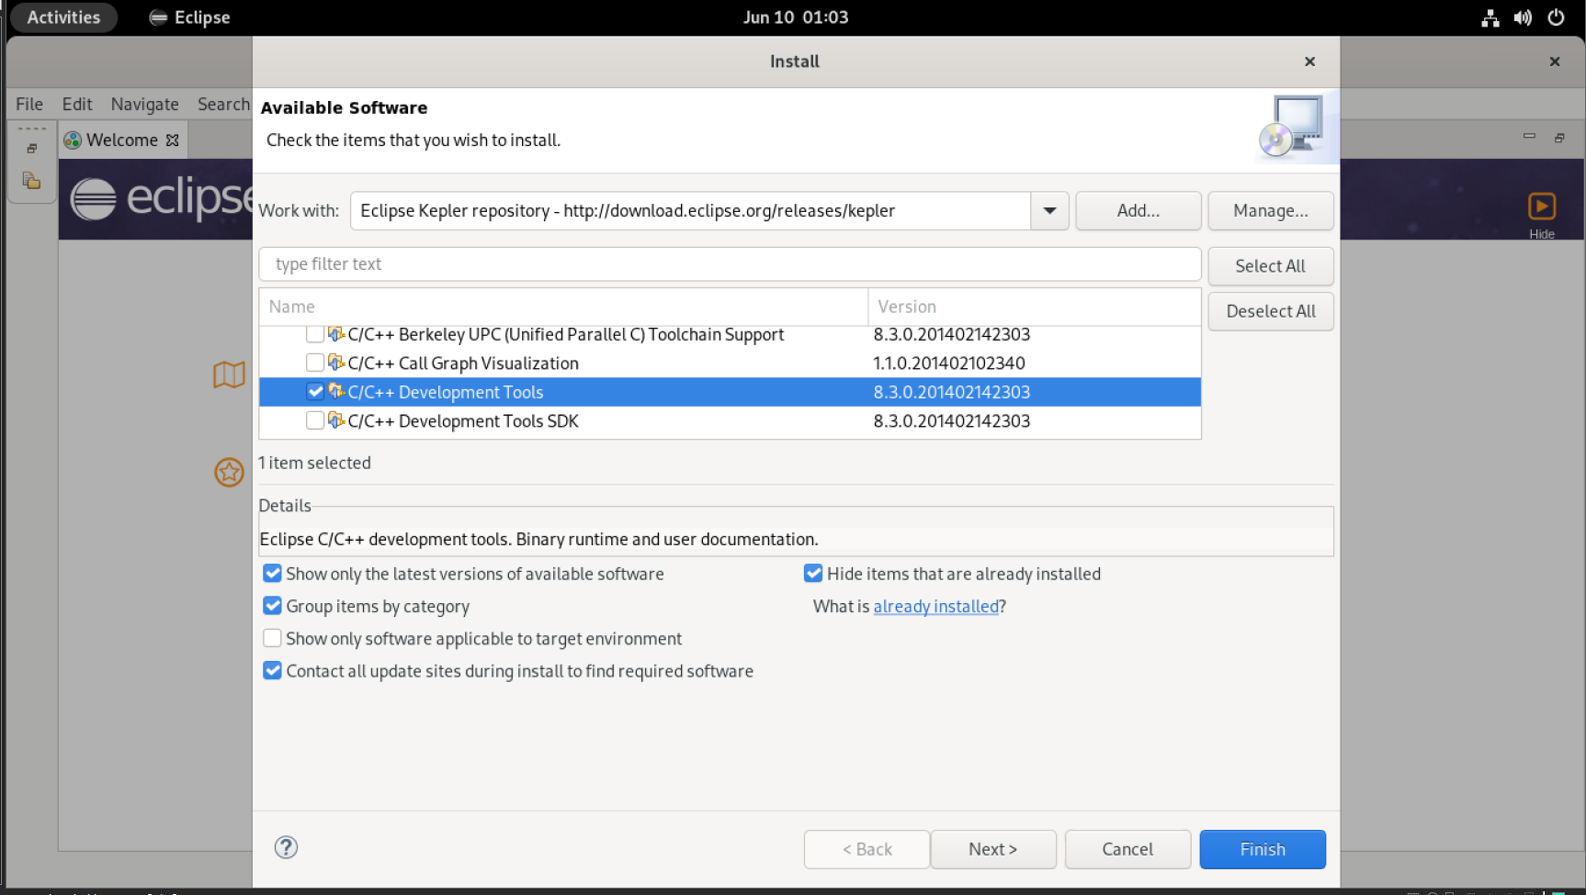
The GCC compiler had already installed on the machine.
Then I have to install a C/C++ Development Tools (CDT) inside Eclipse IDE.
It was done by using a plug-in in Kepler packages (through install new software inside Eclipse.
3.1. Use YUM to install package
04
In the “Name” field, expand “Programming Language” and check the option “C/C++ Development Tools”.
16

Slide 17
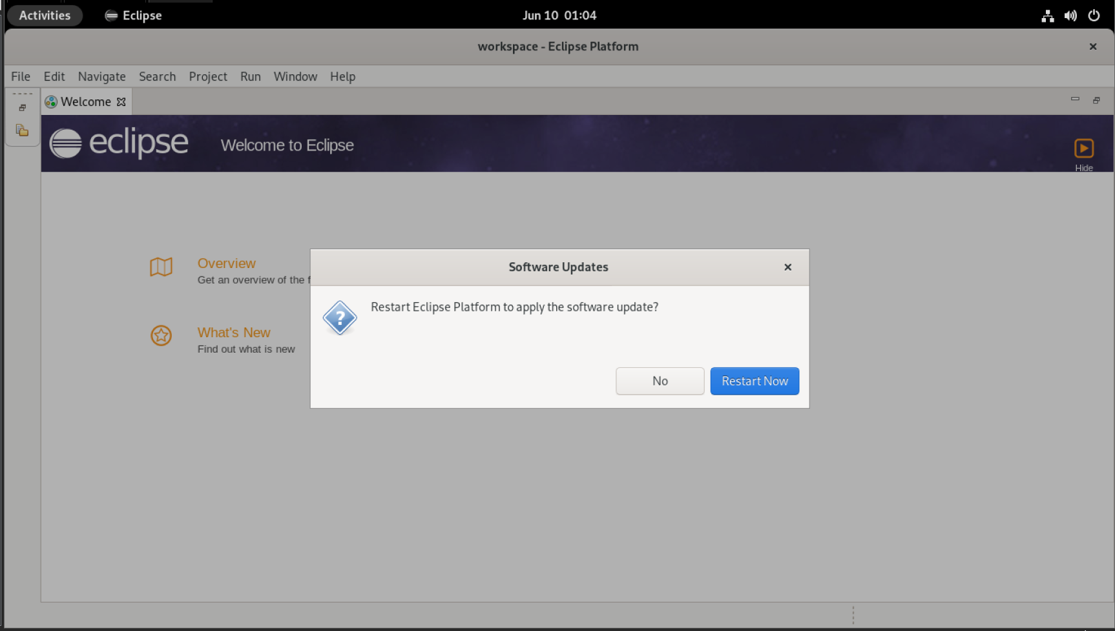
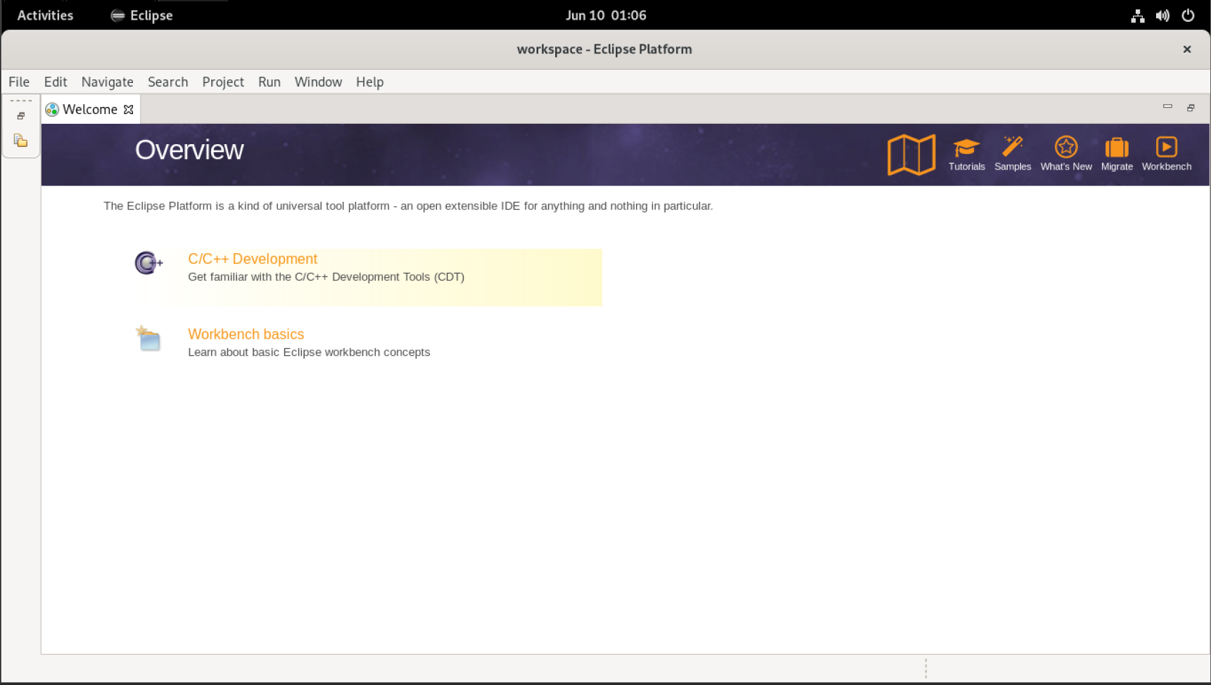
The screen display a successfully installation message and then I re-launch Eclipse.
3.1. Use YUM to install package
Eclipse interface after installing CDT.
17

Slide 18
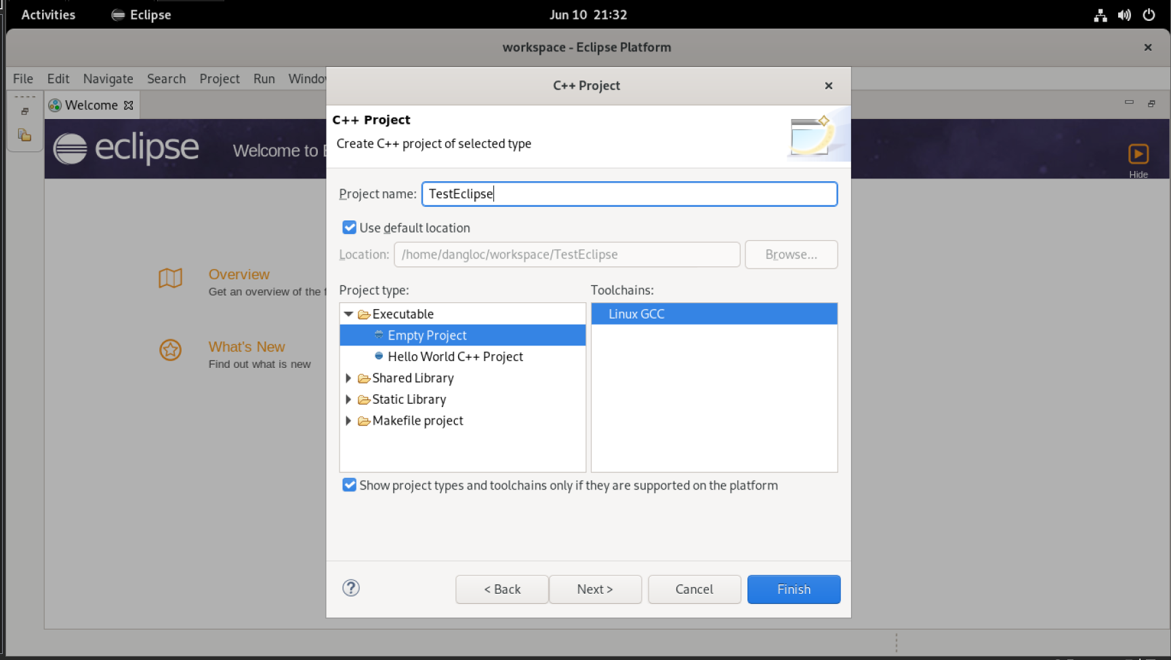
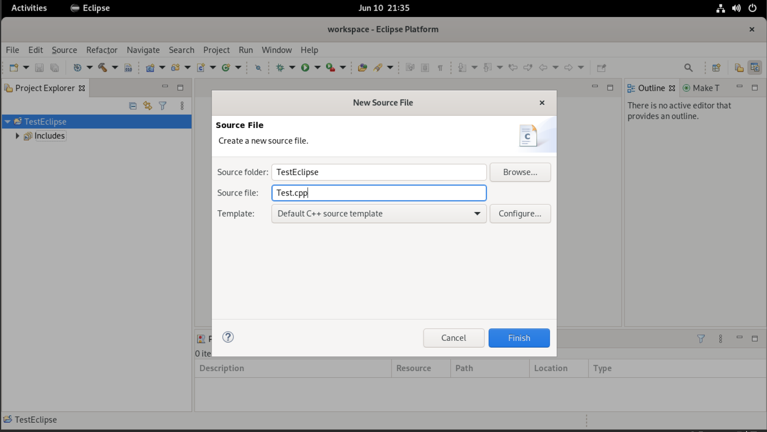
The next step is configuring Eclipse IDE. MinGW binaries are included in the PATH environment variable. CDT searches the PATH to discover the C/C++ compilers.
Specify the name of the project. Then I select an Empty project and the compilers on the system are listed under “ToolChains”. I select the Linux GCC compiler and then click Next.
The new C++ project was created and I create a new source file named “Test.cpp”
18

Slide 19
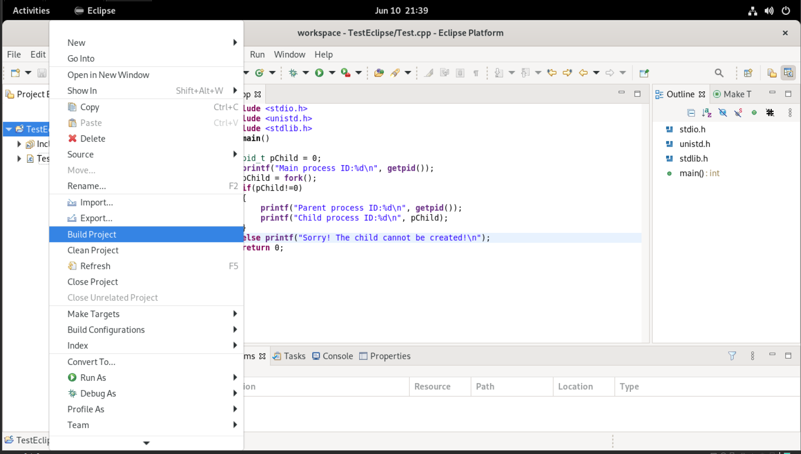
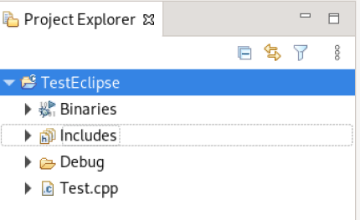
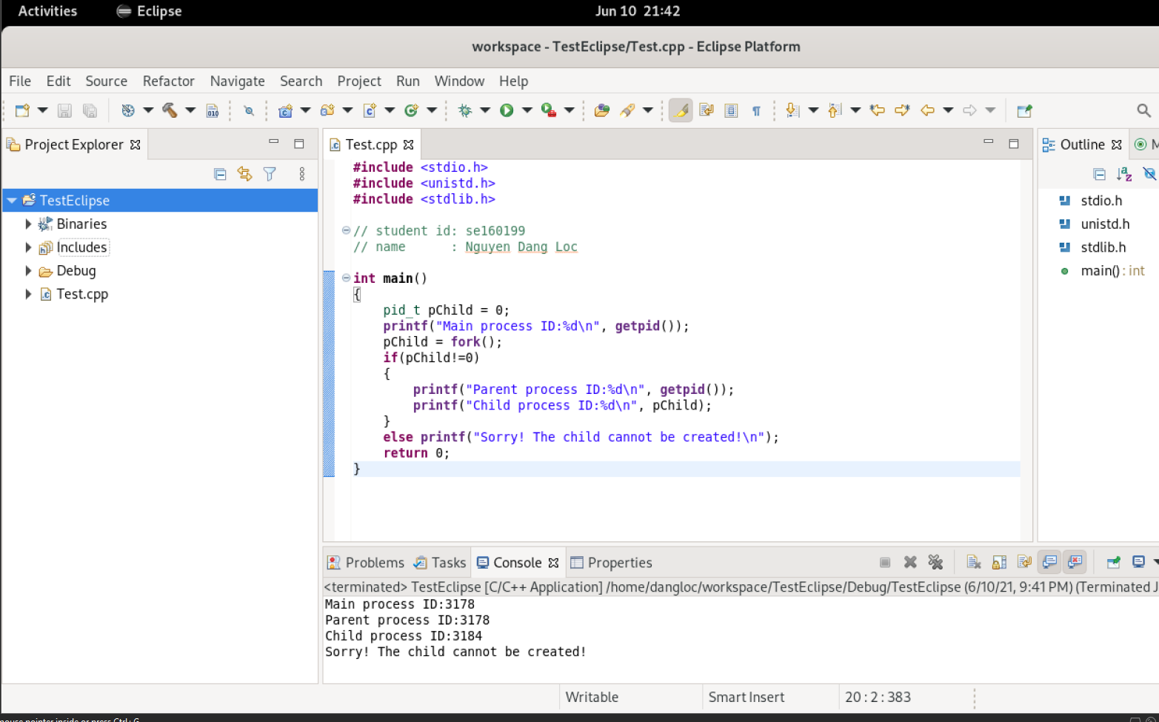
Click on Build Project to start compile and prepare for executing the project.
3.1. Use YUM to install package
The project successfully and a binaries file was made, it’s necessary to run the program.
The program run successfully and the output as shown in the Console window.
19

Slide 20



3.2. Create a object-oriented Project in Eclipse IDE
I created a new C++ object-oriented project and named it “ObjectEx”.
All the following steps are the same to the earlier part (previous slide).
After a mean time of coding, the Main class with 2 classes Rectangle and Box were created.
I build the whole project and a successful message displayed, there were no error arise.
Execute it and the results are as displayed.
20

Slide 21
Thank you!
By Nguyen Dang Loc

